Slide 1

Lenguaje de Programación
Unidad VI: Otros paradigmas de programación

Slide 2
Crear Base de datos: bdregisters
CREATE TABLE cities (
id INT AUTO_INCREMENT PRIMARY KEY,
name VARCHAR(255),
status BOOLEAN
);
CREATE TABLE jobsJ(
id int AUTO_INCREMENT PRIMARY KEY,
name varchar(255),
status boolean
);

Slide 3

Crear Base de datos
CREATE TABLE employees (
id INT AUTO_INCREMENT PRIMARY KEY,
nombre VARCHAR(255),
ciudad_id INT,
job_id INT,
salary DOUBLE,
status BOOLEAN DEFAULT 1,
FOREIGN KEY (ciudad_id) REFERENCES cities(id),
FOREIGN KEY (job_id) REFERENCES jobs(id)
);

Slide 4

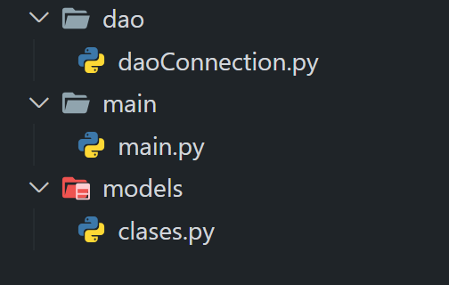
Abrir carpeta
Cree una carpeta llamada ConexionBD
Dentro de esta carpeta cree las siguientes carpetas.
Si el main no importa las clases alojarlo en la raíz de la carpeta principal.

Slide 5

Clase Connection
import mysql.connector
class Connection:
def __init__(self, host, user, password, database):
self.host = host
self.user = user
self.password = password
self.database = database
self.cnx = None
self.connect()
def connect(self):
self.cnx = mysql.connector.connect(user=self.user, password=self.password, host=self.host, database=self.database)

Slide 6
Clase Connection
def close(self):
self.cnx.close()
def execute_query(self, query, params):
cursor = self.cnx.cursor()
cursor.execute(query, params)
self.cnx.commit()
cursor.close()
return cursor
def execute_read_query(self, query, params):
cursor = self.cnx.cursor()
cursor.execute(query, params)
result = cursor.fetchall()
cursor.close()
return result

Slide 7
Clase DaoCity
class DaoCity:
def __init__(self, connection):
self.connection = connection
def get_all(self):
query = 'SELECT * FROM cities'
return self.connection.execute_read_query(query, ())
def get_by_id(self, id):
query = 'SELECT * FROM cities WHERE id = %s'
return self.connection.execute_read_query(query, (id,))

Slide 8
Clase Connection
def insert(self, city):
query = 'INSERT INTO cities (name, status) VALUES (%s, %s)'
return self.connection.execute_query(query, (city.name, city.status))
def update(self, city):
query = 'UPDATE cities SET name = %s, status = %s WHERE id = %s'
return self.connection.execute_query(query, (city.name, city.status, city.id))
def delete(self, id):
query = 'DELETE FROM cities WHERE id = %s'
return self.connection.execute_query(query, (id,))

Slide 9

Clase City
class City:
def __init__(self, name, status):
self.name = name
self.status = status
def __str__(self):
return self.name

Slide 10

Implementación
import os
import dao.daoConnection as dao
import models.clases
os.system('cls')
conex = dao.Connection("localhost", "root", "", "dbregisters")
conex.connect()

Slide 11

Instanciar
#instanciar modelo
city1 = models.clases.City(0, "Managua", 1)
city2 = models.clases.City(0, "León", 1)
city3 = models.clases.City(0, "Granada", 1)
city4 = models.clases.City(0, "Masaya", 1)
city5 = models.clases.City(0, "Estelí", 1)
city6 = models.clases.City(0, "Jinotepe", 1)

Slide 12

Insertar registros
#insertar
daoCity.insert(city1)
daoCity.insert(city2)
daoCity.insert(city3)
daoCity.insert(city4)
daoCity.insert(city5)
daoCity.insert(city6)

Slide 13

Mostrar registros
#consultar
cities = daoCity.get_all()
for city in cities:
print(city)

